Slide 1

LatentView Capability demonstration
August, 2018

Slide 2
Agenda
1
Capability demonstration
1.1
Integration large volume of data from multiple sources
1.2
Our expertise in cloud platform
1.3
Other case studies

Slide 3
Integrating large data from multiple sources
LatentView Confidential

Slide 4
Why do we need to look beyond traditional data
Automotive sector becomes more customer-centered
In today’s information-intensive climate, automakers must continue to use data to better understand the needs, desires, and journeys of their customers.
Customer experience is the key to creating value in automotive
Auto industry has recognized that it needs to build relationships with their customers beyond the average four-year upgrade cycle to the latest model, and that they cannot leave this to the dealership.
Big Data and Analytics is helping leaders gain competitive advantage
The exponential growth in IOT devices and other data technologies has opened gates for automobile industry to tap into the potential of data analytics and gain actionable insights

Slide 5




Key data sources in Automobile industry
Product
Service
Market
Customer
Vehicular profile
Vehicular sensors
Embedded systems
Connected services
Warranty
Service history
Mechanic logs/notes
ERP
Vehicular health
Sales and Marketing
Dealer information
Govt. and regulations
Supplier collaboration
Customer profile
Driving behavior
Social media chatter
CRM touchpoint
App and web usage

Slide 6



Integrating large volume of data from multiple sources
Key questions that need to be addressed
1
2
3
How to acquire data?
How to create a unified data view?
How to enable consumption?

Slide 7
Integrating large volume of data from multiple sources
Key questions that need to be addressed
1
2
3
How to acquire data?
How to create a unified data view?
How to enable consumption?
Identify the correct tools to combine data from different sources based on the data type
Prioritize between clouds based platform vs an on-premise data lake creation, based on business requirements
Enable support for Visualization or Machine learning techniques like Forecasting, clustering and other advance analytics

Slide 8


Integrating large volume of data from multiple sources
How to acquire data?
How to create a unified data view?
How to enable consumption?
Data Integration
CANNED REPORTS
Conventional Data Sources
Structured
Relational Data Store
(Ex: AWS Redshift)
Enterprise Reporting Platform
SELF SERVICE BI
Unconventional Data Sources
Data Lake
(Example: S3)
API endpoints
Indexing and Querying
(Ex: Elastic Search)
OPERATIONAL
External Data Sources
Unstructured
Machine Learning Workbench
ADVANCED ANALYTICS
Distributed Processing
Feature Engineering
Data Sampling
(Ex: Spark)
Internal Data Sources
Real time Indexing
(Ex: Elastic Cache)
REAL TIME REPORTING
Data Type specific ETL toolset
Isolating Compute from Storage
Workload Aware Compute

Slide 9



Examples of some of our previous work
Leveraging IOT sensor data to mine insights on driving patterns
Enabling cloud infrastructure to generate real time product recommendations
Improve service levels by leveraging analytics on multiple segments across supply chain
Leading German automobile player
Leading Food distribution company
Leading Home Appliance Repair Services provider
Profile Driver behavior to predict vehicle risks and estimate warranty costs using IOT data
Converge data from silos into a centralized cloud based platform to build a recommendation engine
Enhanced the business performance from existing 45% to 95% service levels that impactted13 Million Customer Service requests annually

Slide 10

1. Profile driver behavior using IOT sensor data
LatentView developed and delivered SMART INSIGHTS tool, a scalable and self-service platform for analytics on connected vehicles
Solution
TECHNOLOGY State of art open source technologies like Scala, Spark, Data bricks
SCALE Built on 4.5 million cars & 2.8 Million Warranty Claims across multiple geographies
AGILE Delivered under 6 months
INNOVATION Superior analytical capabilities through simplified user experience
Key Highlights
Complexity
IOT Data from cars all over the world, merged with local warranty claims and built Machine learning solution on top of it
Features
Exploratory Analytics
Warranty vs Features
Vehicle Segmentation
Risky Neighbours
Analysis
Connect Product Usage with Warranty Repairs & Features
Predicting Risk for Similar Profiles
“Cars showing Short Trip & Long Pause behavior have a 40% higher chance Engine related failures”
Vehicles that spend 100% more on Pedal position are at a 250% risk of engine related defects.
Sample
Insights
Demo

Slide 11



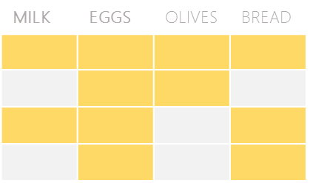

2. Recommendation Engine for food distribution company
The Problem: In an industry where customer acquisition is fairly expensive, this company’s repeat orders were at a low 4%
The “Before” State
LatentView Solution
The “After” State
Sales teams tried to sell new products to existing customers based on shallow analysis of previous transactions and ‘gut’ feel
Build an innovative recommendation engine that combined customer segmentation, user-based collaborative filtering and market basket analysis
20% increase in value of new orders from existing customers. Higher customer satisfaction due to precise recommendations
Collaborative Filtering
Market Basket Analysis
Items Purchased:
Items Purchased:
Market Basket Analysis performed for all products bought by customers in a segment. Select the product with highest likelihood to co-occur in the basket
Similar
Customer B
Milk
Eggs
Milk
Eggs
Bread
Customer A
Customer C
TRX1
Milk
Eggs
TRX2
Recommend Bread
User-User Similarity - similarity is calculated between customers within a segment based on common products in basket using Cosine Similarity
TRX3
Recommended
Bread
TRX4
Recommendation Engine
Combine the recommendations from the 2 algorithms to generate the final recommendation
For a Customer who purchases Milk & Eggs, the product with highest affinity is Bread

Slide 12





2. Scaling up the machine learning solution to Big data
Built a product recommendation system for a leading food distribution company
and later scaled it up to include all 72 op-cos and all geographies leading to ~20% increase in the new orders by existing customers
Phase 2
Big data platform providing Machine learning solutions for 72 op-cos
Phase 1
Enabled Distributed processing and data pipelines for data across geographies
On Premise machine learning solution for 7 op-cos
Custom built cloud based tool delivering insights like:
Recommendation system for cross-sell opportunities (customers & deals)
Next best product recommendation
Data dimensions
Customer Segmentation
Customer
Order Anomaly Detection
Transaction
User Based Collaborative Filtering
Product Substitution
Geography
Market Basket Analysis
Revenue Management Use Cases
Products
Price
Final Recommendations
Real time recommendations
40K customers data
36X faster than linear approach
Serves 72 op-cos across USA

Slide 13

3. Improving Home Service Requests Operational Efficiency
Objective : To enhance the customer service request fulfilment rate from existing 45% to 95% for ~13M Customer Service requests annually
Approach: Disintegrated the business goals into 3 key business processes that needed attention and build a scenario simulation tool
1
2
3
Business Process
Demand Planning
Workforce Planning
Inventory Planning
Scenario Simulator
High variance between forecasted demand and actuals
Delay in tech allocation and scheduling
Replacement Parts not available
Focus area
More granular forecasting to match supply
Optimize tech allocation for granular demand
Optimize truck stock and order – tech – part match
Analytics Solutions
Reallocation of supply in response to gap/surplus
Accuracy up to 92% from 65% reducing lead time by 20%
$5 million per annum in incremental revenue as a result of reduced cancellations
10% reduction in reschedules, resulting in lower trips per repair
Enabled identification of $300,000 opportunities every year
Impact
1M parts and 1.2 million calls data processed in 12 weeks across 40 districts and 8K segments
Advanced forecasting techniques which integrate external factors like weather, holidays etc.
Integration with the existing infrastructure/tools and data ETL support
In use by 100+ capacity planner and managers

Slide 14
Expertise in cloud platform
LatentView Confidential

Slide 15


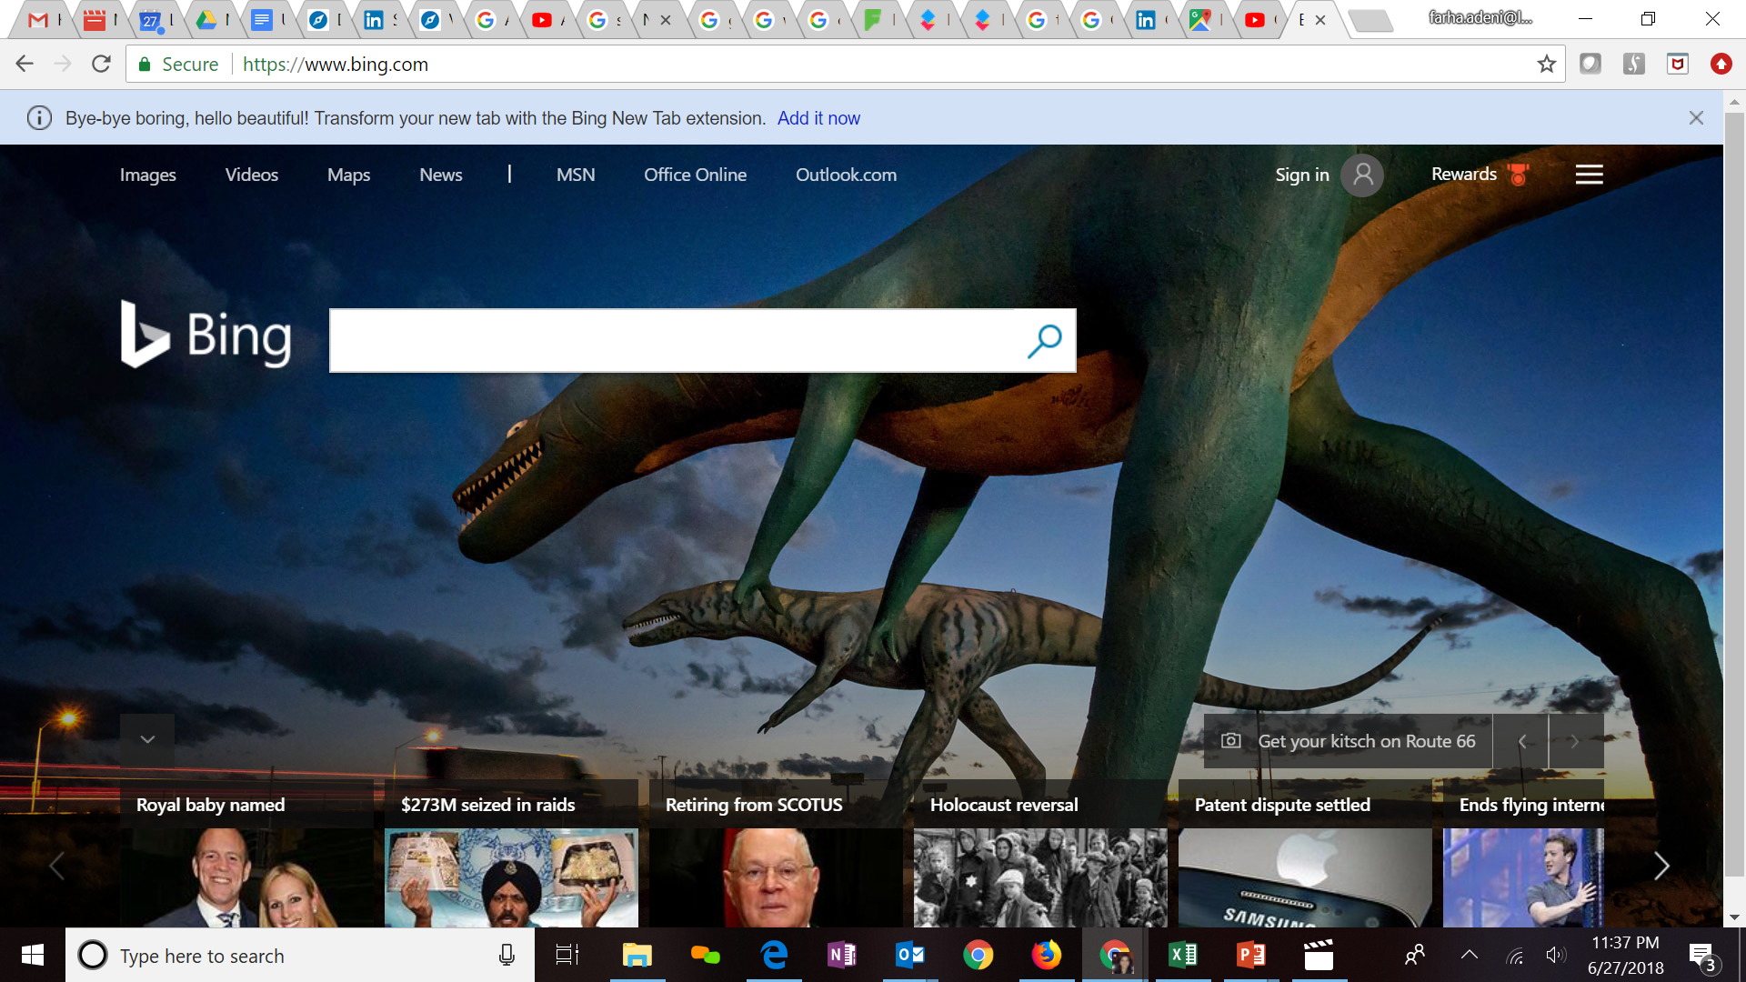




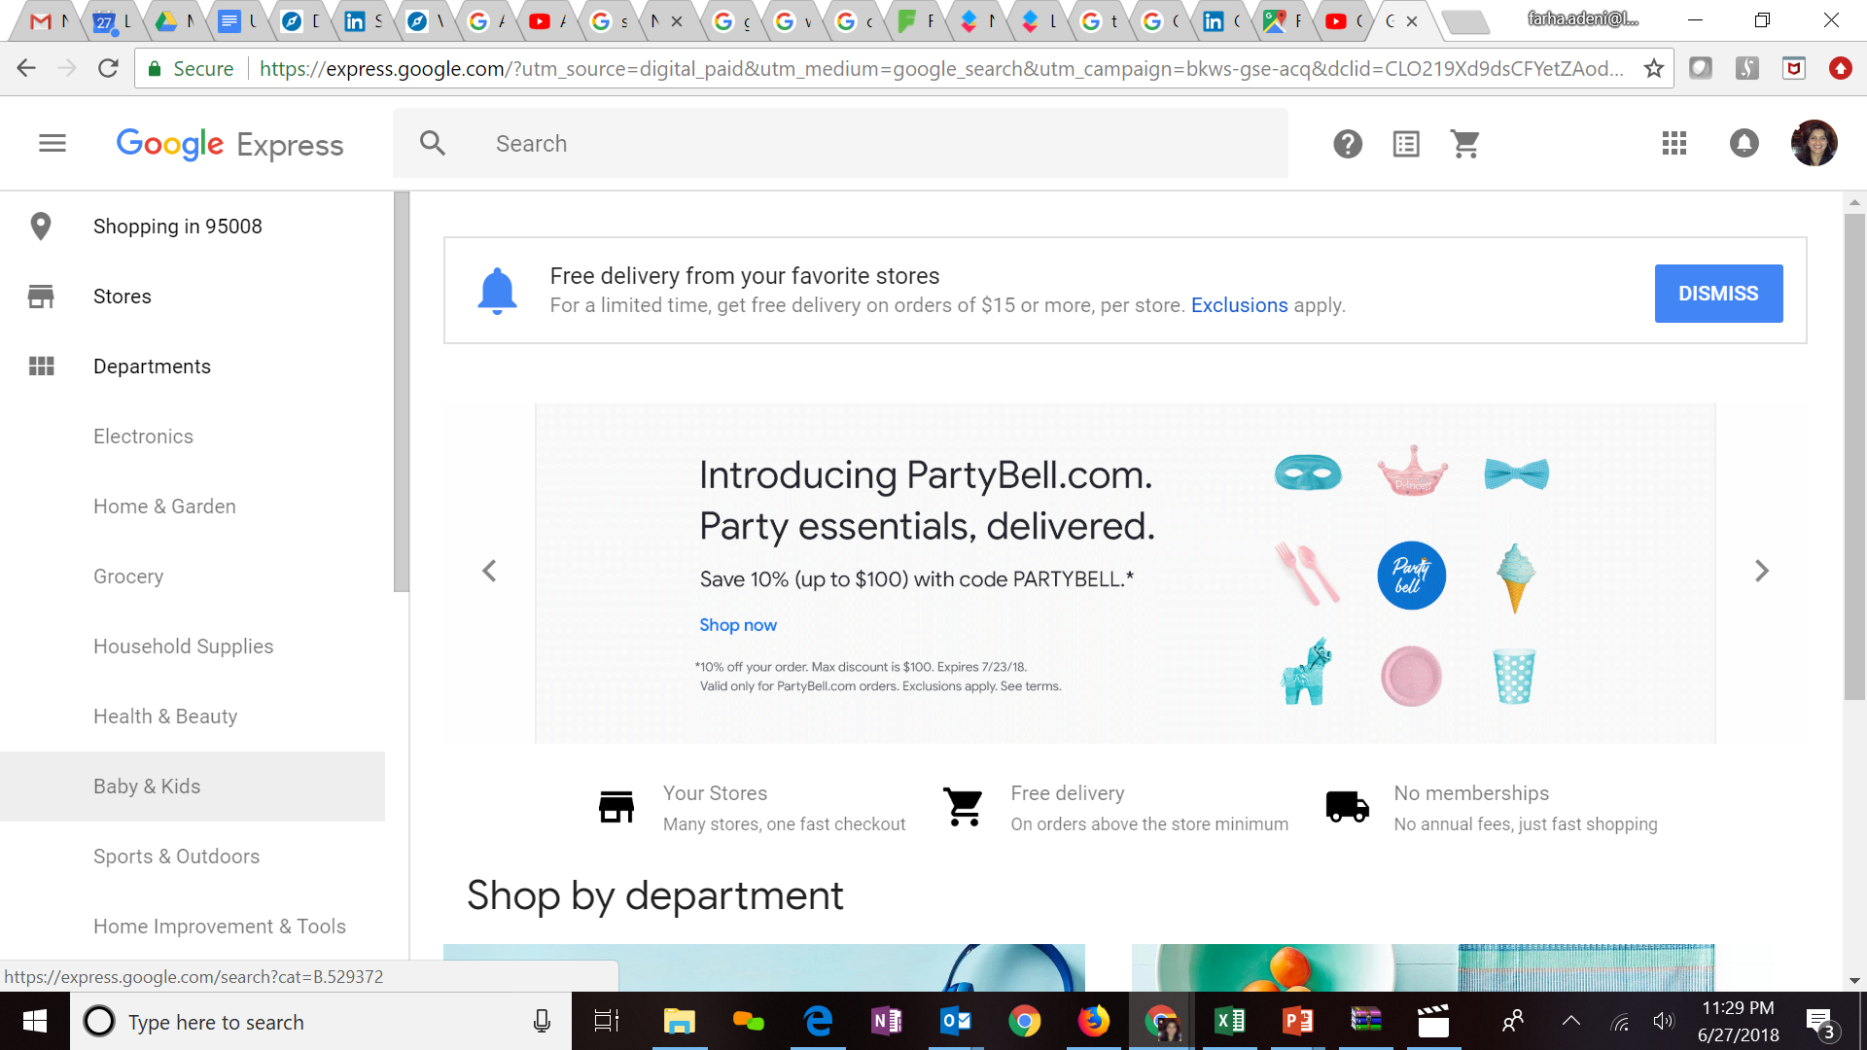


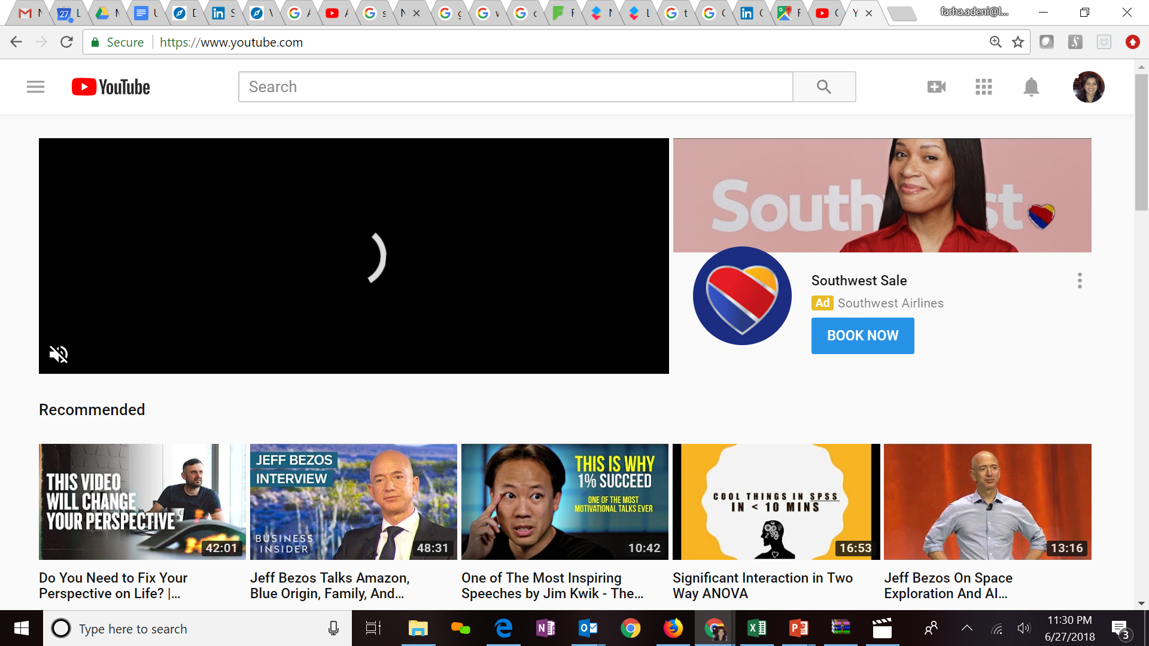
Expertise in Cloud platforms
Key Clients
LatentView is a Microsoft Gold Analytics Partner
Model Automation Framework – LatentView scalable ML solution built in Azure hosted on Microsoft Appsource (link)
Key Participants of MS Tech-ED 2014, Azure Training
Managed Analytics in Azure using AzureML, PowerBI, Azure data factory, Azure Search, Azure data lake analytics etc.
LV is Advanced Analytics Consulting Partner
Key Presenters of AWS Re-Invent, Business Summit
60 TB cloud migration exercise completed in 3 months
Processing 500+ GB unstructured data per week
Multiple enterprise solutions deployment experience
Managed Analytics in AWS using Amazon ML, Cloudsearch, Kinesis, QuickSight etc.
Extensive experience in handling GCP products- AppScript, CloudSQL, Appmaker, Big Query etc. Deep Technical Capabilities to work in this platform
Multiple solutions deployment experience for Google projects
Managed Analytics in GCP using MapR, Cloud ML, Cloud dataflow, Google data studio, Cloud SQL
Notes:
Q – Anup can you update some of the details

Slide 16
Appendix
LatentView Confidential

Slide 17
LatentView- Data Engineering Capabilities
Applications
Data Strategy
Data Lakes
Data Warehouse
Visualization
Decision management systems
IoT Applications
Data Monetization Roadmap
Cloud Strategy & Architecture
Architecture Evolution
Data Integration / Consolidation / Harmonization Framework
Optimizing BI Investments
Data Engineering
Capabilities
Technology
Engineering
Hadoop: Hive, HBase, MapReduce, PiG, HDFS, Phoenix
Spark – Scala, Python, Spark SQL
Flume, Kafka, NiFi, Sqoop
Spark Streaming, Storm
AWS, Azure, Kylo, Qubole, Databricks
Structure Data Flows
Ingest streaming & batch data
Data storage and data model
Batch and Real time processing
Real-time, Graph, Search & Iterative workloads
Orchestration
OCM & Managed Services
Organizational Change Mgmt
Governance
Maturity Assessments

Slide 18




Snapshot of Select Projects : Data Engineering
Warner Bros
Hitachi Vantara
Built a high throughput, high volume clickstream data pipeline that enables a 360 degree view of the customer and helps product teams to see deep in to what drives user behaviour and how they can impact it.
Drives 1/3 of all business insights
Complex queries with sub minute response on TBs of data
10x faster than conventional setup
Provisioned cloud based scalable infrastructure and seamlessly migrated and enabled access of existing VPC’s, Subnets, IAM Users & Roles, Environments, Dashboards etc. supporting the digital supply chain processes for Home Entertainment
Enabled fast analytical querying, particularly on large datasets
Ensured on-time delivery of the digital contents resulting in $500K annual savings
Assessed existing data & reporting architecture of organization and redesigned the architecture and KPI framework inline with business objectives along with a detailed analytics roadmap for the organization.
Analytics Roadmap
Business & Analytics aligned architecture
Consulting on the ongoing implementation\

Slide 19
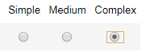
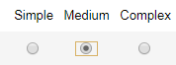
Visualization Capabilities
Client | Data Sources & Processing | Data Visualization | Implementation Style | Dashboard Demo
Global Beverage Leader | 15 distinct data sources . 60+ ETL jobs performed on a weekly basis | Customized by Geography across Supply chain, HR, Marketing & Media Analytics | Built on Tableau v10.2. Customized by Geography across Supply chain, HR, Marketing & Digital teams | Demand GKPI SOM FD
American Major Retailer | 50+ ETL jobs from Google Analytics, Teradata, Omniture & Unstructured digital partner sources | Dashboards for operations Heat maps, Pivot tables, user input accepted | Built on Tableau v10.3 integrated with VB.NET Web app on Azure | Assortment CAT
Global Music Giant | 35+ ETL sources from different finance databases maintained | 15 C-Level dashboards to CFO & CEO reporting on Global Financial position | Built on Tableau v10, Navigate through geographies using links in the visual data points | CFO Dashboard
German Luxury Auto | Evaluating various Business Hypothesis involving Driving styles & Warranty Claims using car sensor data & claims data | Visualize correlation between driving style and warranty claims based on defect instances | Visualized through Tableau v10.3 and also Databricks platform with Apache Spark on backend | DrivingPattern Hypothesis
Large Appliance Manufacturer | Unstructured review data scraped from public domain and ecommerce | SKU, Brand and Category level comparison of features & purchase drivers | Built on Tableau v10.1 with an internal version on client hosted SAS VA server | Voice of consumer
Notes:
Pandora – Demand Forecasting

